Slide 1
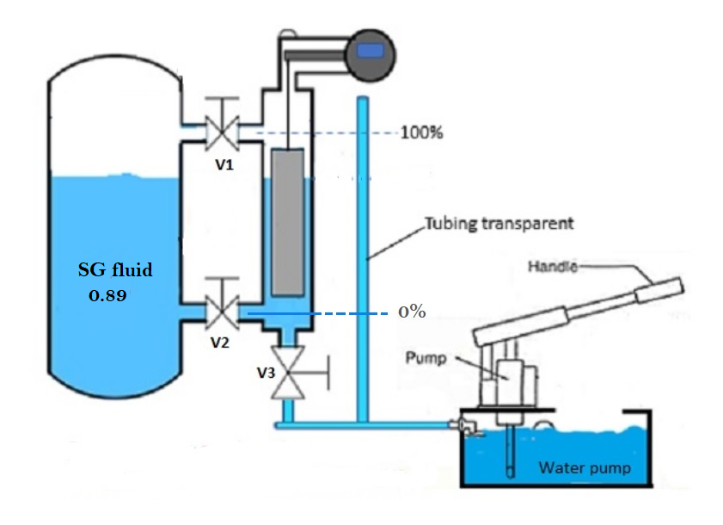
Magnetrol Level Transmitter Calibration
650
mm

Slide 2
Calibration Procedure.
1. Follow safety precaution before starting job
2. Release pressure from transmitter chamber.
3. Arrange calibration set up as per drawing .
4. Notify SG of process fluid, notify 0% level line and
100% level line, measure distance from 0% to 100%
5. when chamber empty ensure transmitter out put 4mA,
adjust zero button when required.
6. Fill chamber with water up to full calibration line, ensure
out put 20mA, adjust span button if required

Slide 3
How to find full calibration line (FCL).
(refer to the drawing for example)
fluid SG= 0.89
distance from 0% to 100% = 650mm
Full Cal Line ----> 650 X 0.89 = 578.5 mm
measure distance 578.5 mm from 0% line , mark as full calibration line.
Fill chamber with water till FCL
verify transmitter out put, adjust span button when necessary.
Repeat the step till transmitter out put satisfied.

Slide 4
